Slide 1
Multi cycle MIPS CPU (Hardwired Controller)

Slide 2
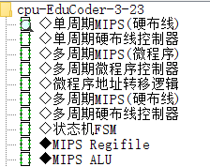
设计内容
MOOC“Computer Hardware System Design”
（1）6.1 Single cycle MIPS architecture（Review）
（2）6.2 Multi cycle MIPS architecture
（3）6.3 Single cycle MIPS CPU design (8 instructions)（Review）
（4）6.4 Multi cycle MIPS CPU (Microprogram Controller) Design
（5）6.5 Multi cycle MIPS CPU (Hardwired Controller) Design
https://www.icourse163.org/course/HUST-1205809816
MOOC“Computer composition”
（1）6.2 Data path design
（2）6.8 Hardwired controller design(1)
（3）6.9 Hardwired controller design(2)
https://www.icourse163.org/learn/HUST-1003159001
Circuit design：
Sports watch
Single cycle MIPS CPU (8+3 instructions)
Multi cycle MIPS CPU (Microprogram Controller, 8 instructions)
Multi cycle MIPS CPU (Hardwired Controller, 8 instructions)
Single cycle MIPS CPU (24 instructions)
cpu-EduCoder-3-23.circ

Slide 3
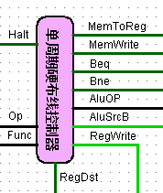
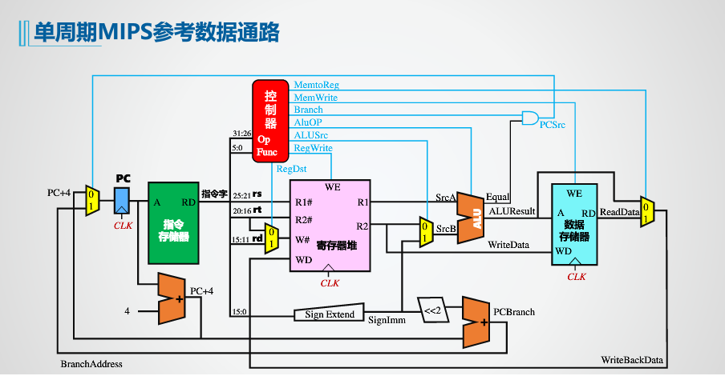
CLK Rising edge
PCSrc= (Beq & Equal) | (Bne & ~Equal)
Halt

Slide 4

单选题
1分
In a single cycle CPU, which modules are generally divided according to the order of data flow?
A
IF, EX, ID,MEM,WB
B
ID,IF, EX,MEM,WB
C
IF,ID, MEM,WB,EX
D
IF,ID,EX,MEM,WB
提交

Slide 5
多选题
1分
Which of the following statements about modules in a single cycle CPU is correct?
A
IF mainly includes PC and instruction memory
B
The ID includes the read logic of the register file and the controller
C
EX includes ALU
D
MEM includes data memory
WB includes write logic for register files
E
提交

Slide 6
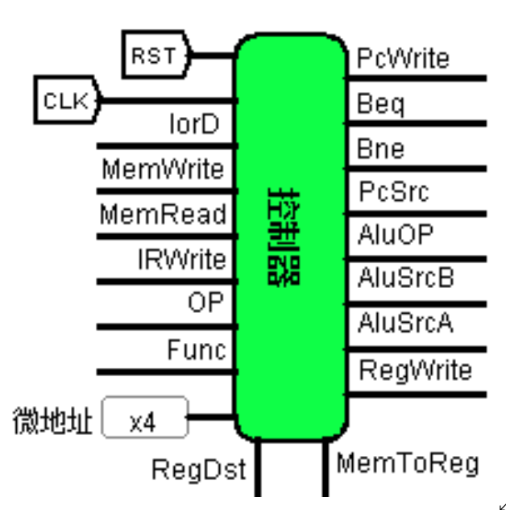
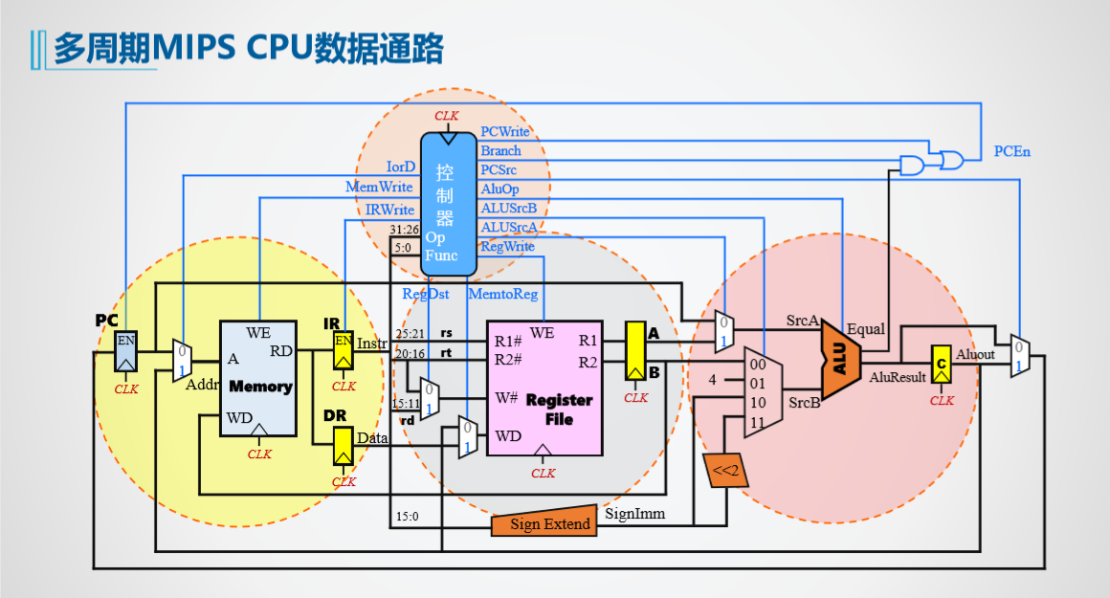
Multi cycle 8-instruction CPU data path diagram (suitable for both microprogramming and hardwired controllers)
CLK Rising edge
PCEn=PCWrite | (Beq & Equal) | (Bne & ~Equal)

Slide 7
单选题
1分
What is the intermediate register of MEM/WB module in multi cycle CPU?
A
IR
B
A/B
C
C
D
DR
提交

Slide 8
多选题
1分
What are the advantages of multi cycle CPUs compared to single cycle CPU？
A
High frequency
B
Different instructions have different durations
The same component can belong to different modules(IF/ID/EX/MEM/WB)
C
D
CPU may not have WB module
提交

Slide 9
The structure of pipeline CPU
IF/ID
ID/EX
EX/MEM
MEM/WB
单周期
控制器
WB
WB
WB
指令字
MEM
MEM
EX
指令字
IR
IR
IR
IR
PC
PC
The structure of pipeline CPU
PC
PC
PC
PC
AluOP
R1#
WE
RD1
A
B
WE
ALU
R2#
ALU
寄存器文件
B
ALU
数据
存储器
MD
W#
RD2
ADDR
RD
Din
Imm
WD
取指令IF
译码ID
执行EX
访存MEM
写回WB
CLK
译码段生成各段所需的控制信号，依次向后传递
Notes:
有了基本的分段和流水接口部件后，我们来看看流水接口中到底锁存什么数据和信息，对于取指与译码阶段直接的接口IF/ID，应该锁存取指段取出的指令IR，以及当前指令的PC，锁存IR容易理解，锁存PC的目的主要是方便后端计算分支地址，因为PC寄存器的值总在变化，必须记住当前指令的PC。 译码段ID可以完全复用单周期实验中的控制器，将指令字翻译成控制信号，另外指令字解析后可以访问寄存器文件，得到16位立即数或32位立即数，这些都是执行阶段所需要的数据和信号，所以ID/EX中需要锁存后续3段所需要的控制信号以及操作数，接口中红色部分是控制信号，绿色部分分别是。。。。。。 EX段使用部分数据和控制信号ALU_OP，运算结构，运算结果会送到EX/MEM接口锁存，由于EX段控制信号已经使用完毕，所以这里控制信号只需要向后传递WB，MEM部分，注意此时IR，PC一直向后传递的目的是为了方便调试，构建时空图，实际流水线中并不需要一直传递。依次内推，Mem、WB接口中包括写回阶段所需的控制信号，和内存数据，alu数据，IR，PC。 总体上看，译码段一次性生成的各段所需的控制信号，并依次向后传递，注意画图传递的控制信号应遵循最后用到的信号在最上部的顺序，以方便绘图，后段绘图空间会越来越大。
建议直接将IR，PC一直向后传，先讲

Slide 10
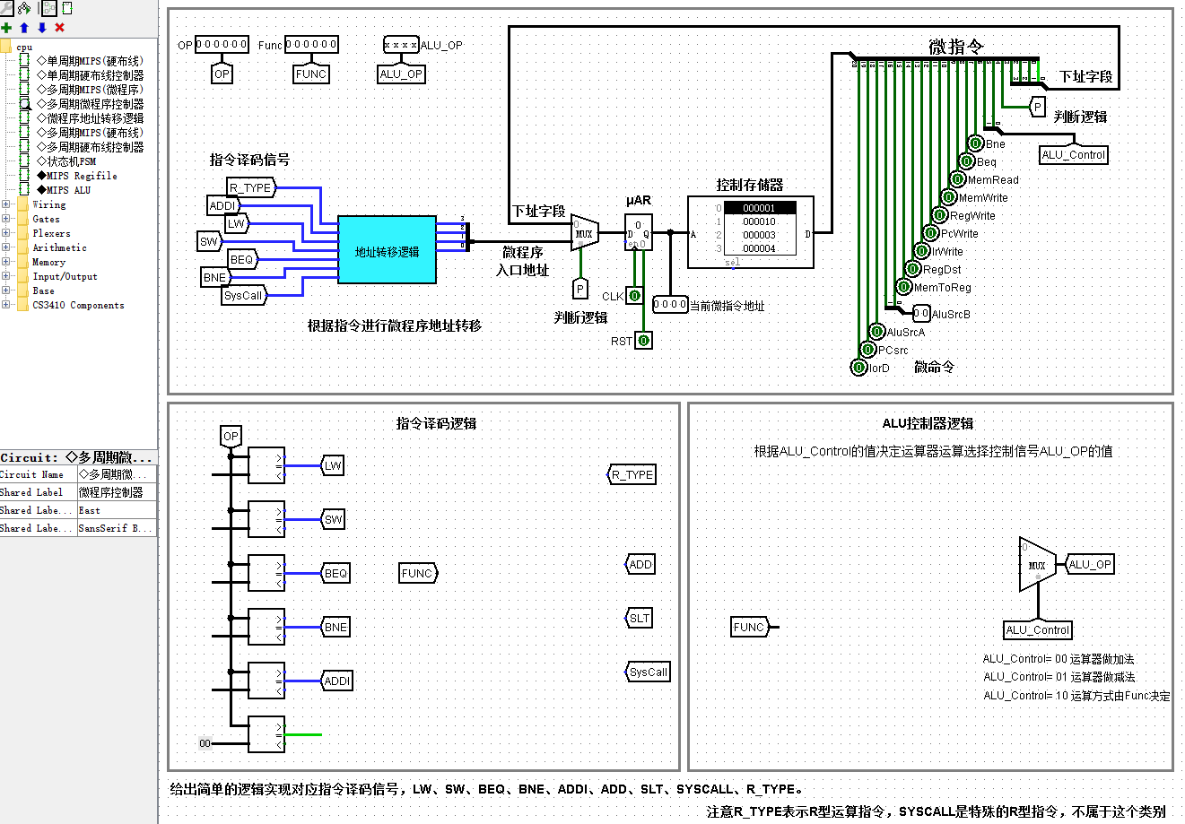
Microprogram controller (input:OP/FUNC/CLK/RST；OUTPUT:ALU_OP,BNE…IorD)
16个字，每字21位
不输出
4位，输出
2位，不输出

Slide 11
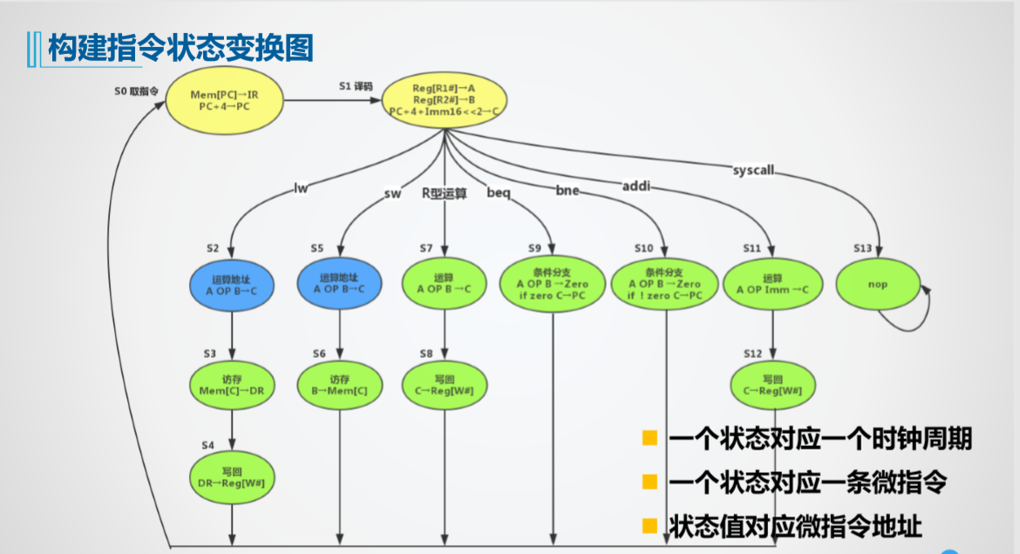
Microprogram flowchart
μI | STATE | ADDR
IF | S0 | 0
ID | S1 | 1
LW1 | S2 | 2
LW2 | S3 | 3
LW3 | S4 | 4
SW1 | S5 | 5
SW2 | S6 | 6
R TYPE | S7 | 7
R TYPE | S8 | 8
Beq | S9 | 9
Bne | S10 | 10
ADDI1 | S11 | 11
ADDI2 | S12 | 12
SYSCALL | S13 | 13
特指ADD和SLT,用Aluop区分
核算地址
A+imm→C
核算地址
A+imm→C

Slide 12
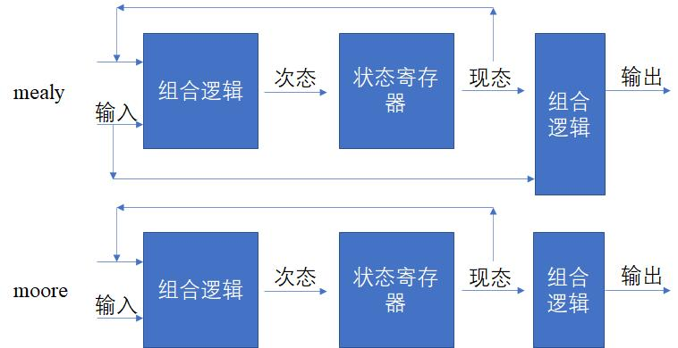
有限状态机

Slide 13
FSM description method:
The status register has 4 bits. S0(0000)…S13（1101）
Using Moor circuit,,designed two combined logic circuit circuits
FSM conversion circuit: input 4 (current state)+7, output 4bits (secondary state)
State output conversion circuit: input 4 (current state), output 16bits(control signal)

Slide 14
多周期微程序MIPS CPU设计任务书：
1.Master the data path of each instruction (8 instructions) in a multi cycle MIPS CPU;
Master the basic principles of multi cycle MIPS CPU (8 instructions) and design hardwired controller;
Design and implement a multi cycle microprogram MIPS CPU with 8 instructions, including hardwired controller design, and CPU data path circuit design,Verificate on TOUGE platform.
Test and run sort.hex
2. Implement verification SUB instructions
3. Implement verification andi instructions
4. Implement verification j or jal instruction
5.Learn the principle of universal tables，write the expressions of the output pins.
Optional question：Other R、I、J type instructions .

Slide 15
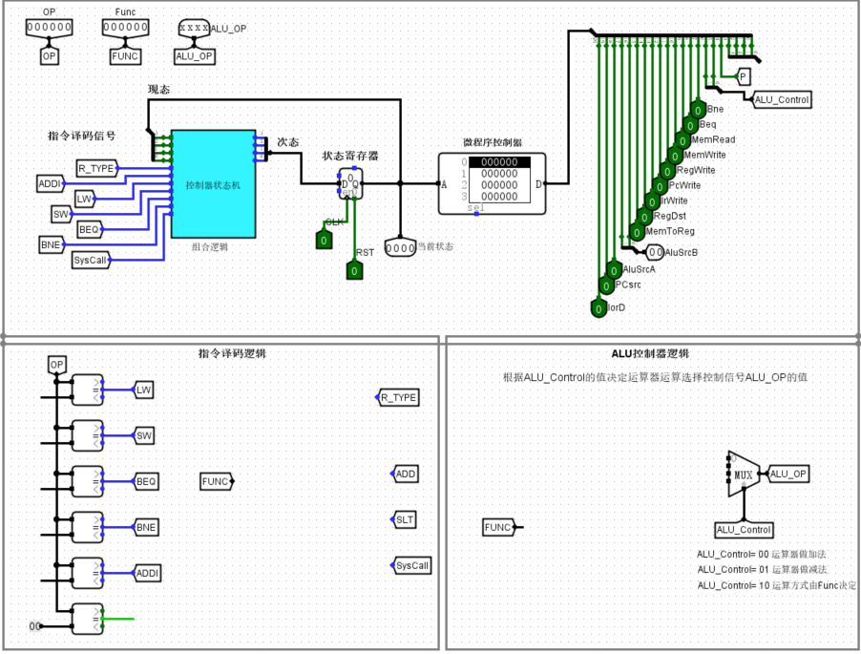
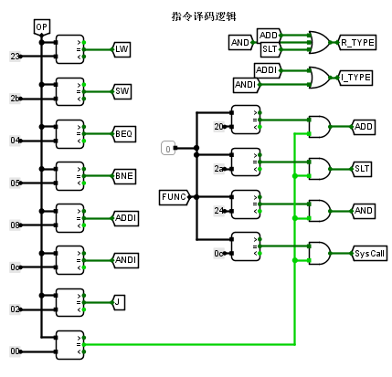
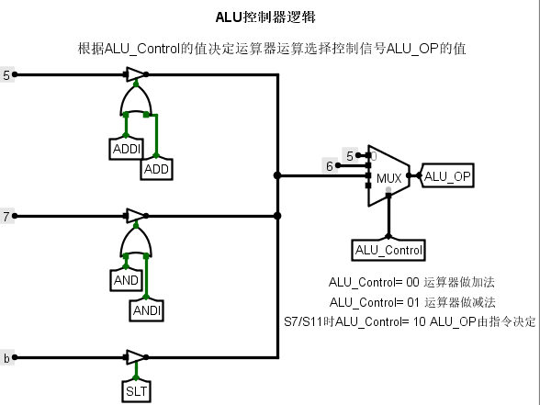
Design FSM output circuit Using ROM(Control Memory)
4位状态寄存器的值相当于S0..S13共14种状态
核心电路
STATE Register
ROM
FSM output circuit
FSM Conversion Circuit
控制存储器

Slide 16
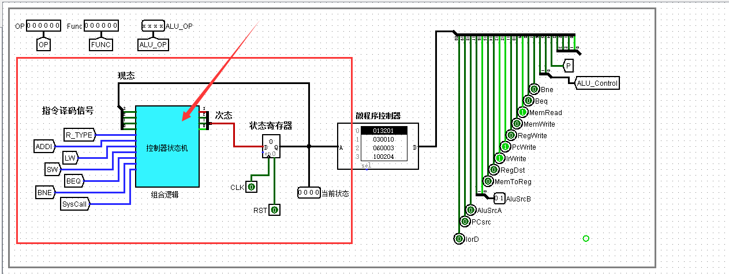
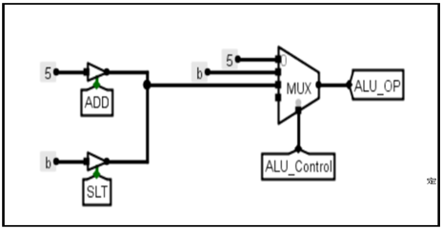
Hardwired controller (you can removing the lower 5 bits of control memory)
Conversion Circuit
4BIT STATE Register
STATE：0000…1101
μI | STATE | ADDR
IF | S0 | 0
ID | S1 | 1
LW1 | S2 | 2
LW2 | S3 | 3
LW3 | S4 | 4
SW1 | S5 | 5
SW2 | S6 | 6
R TYPE | S7 | 7
R TYPE | S8 | 8
Beq | S9 | 9
Bne | S10 | 10
ADDI1 | S11 | 11
ADDI2 | S12 | 12
SYSCALL | S13 | 13
控制存储器
FSM output circuit

Slide 17
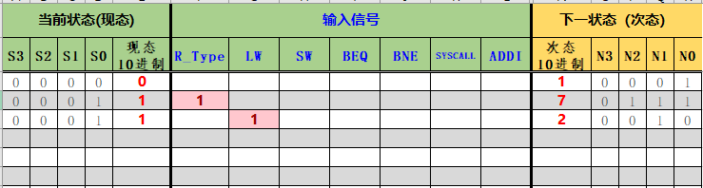
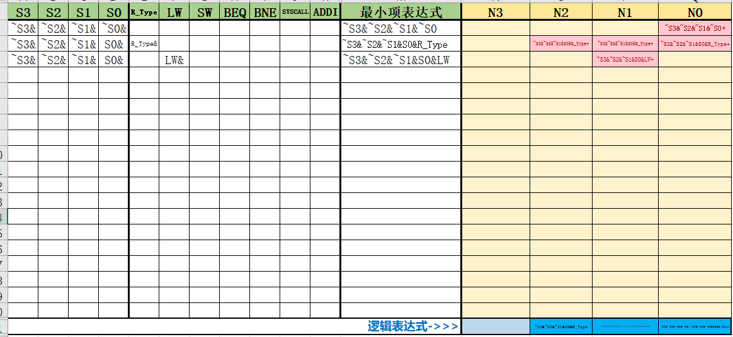
Design Conversion Circuits (For rookie)

Slide 18
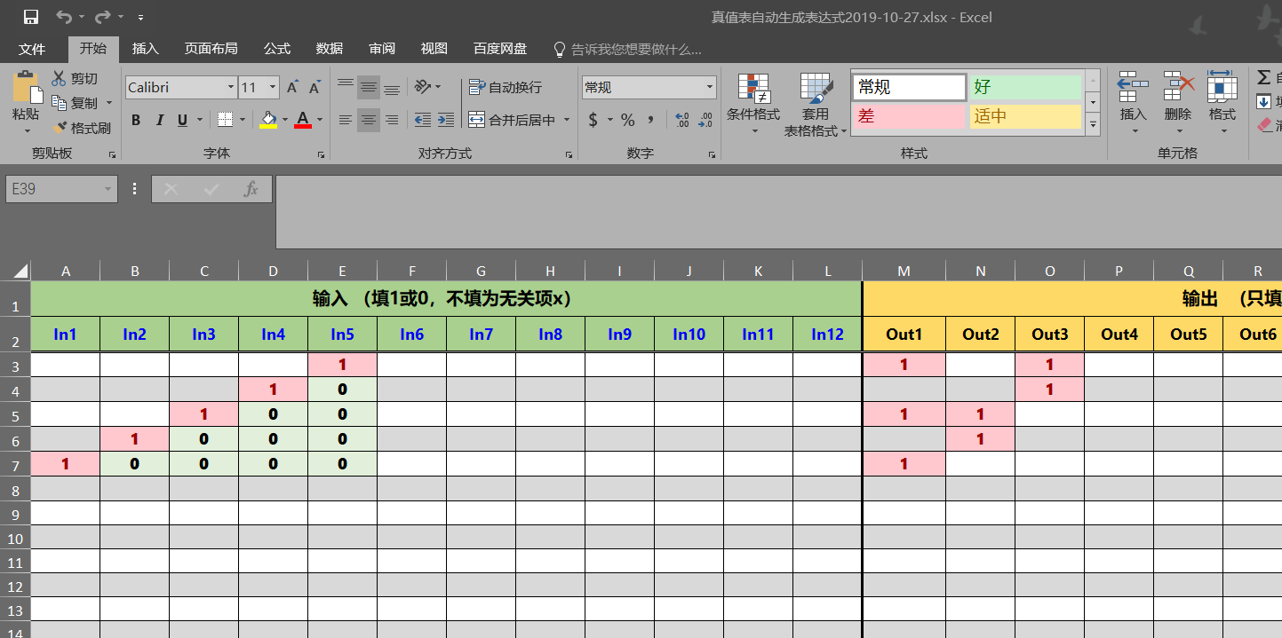
Design Conversion Circuits Using Universal Tables

Slide 19
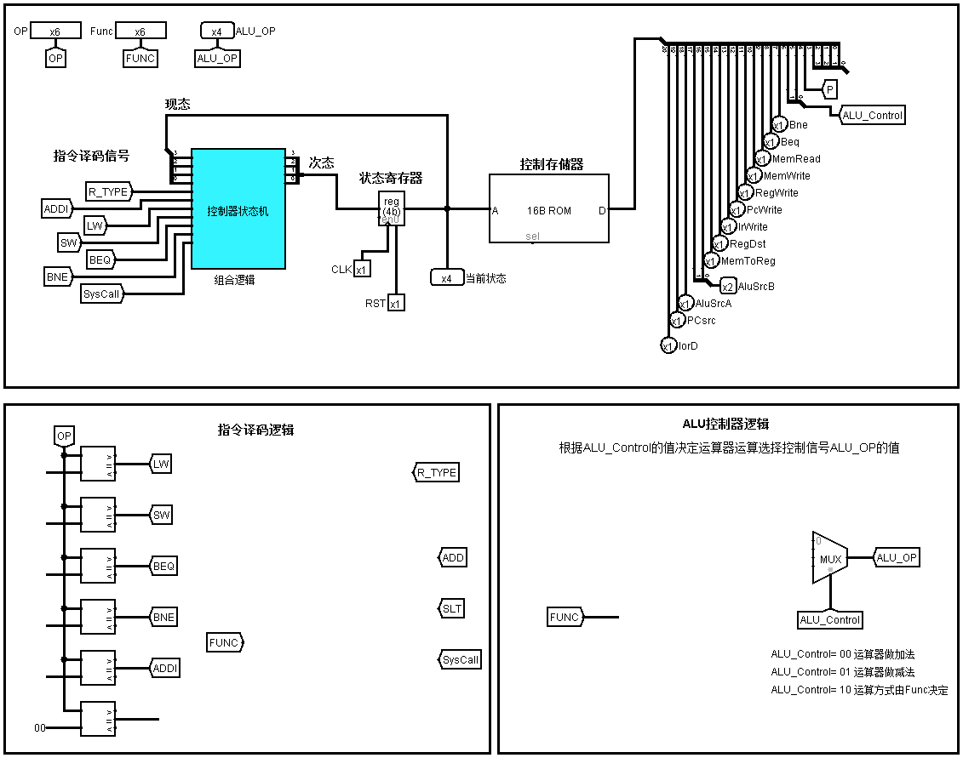
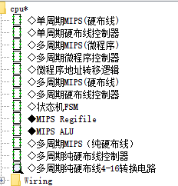
Design FSM output circuit Using Universal Tables
转换电路
4BIT IN，16BIT OUT
Conversion Circuit

Slide 20
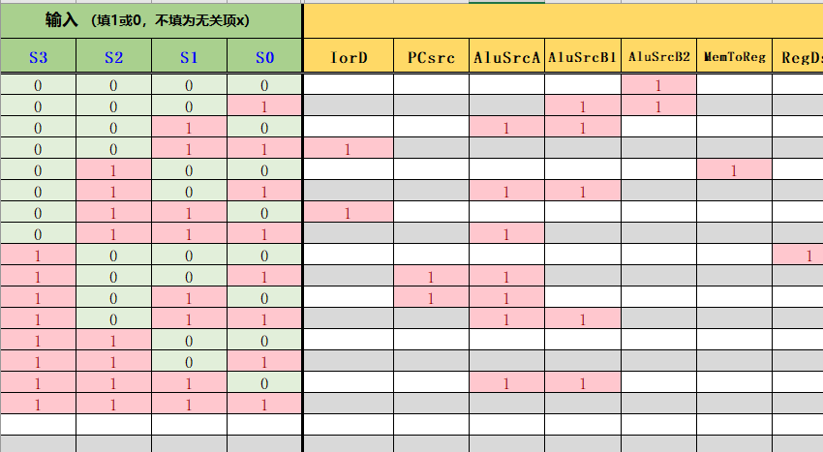

Slide 21
Multi cycle 8-instruction CPU data path diagram (suitable for both microprogramming and hardwired controllers)
PCEn=PCWrite | (Beq & Equal) | (Bne & ~Equal)

Slide 22
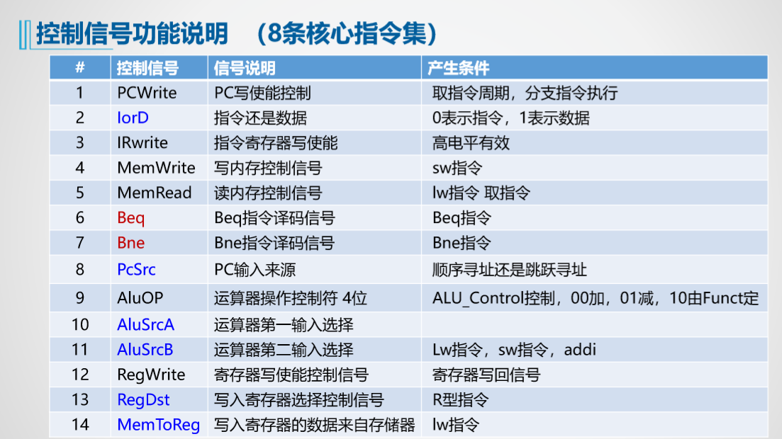
control signals

Slide 23
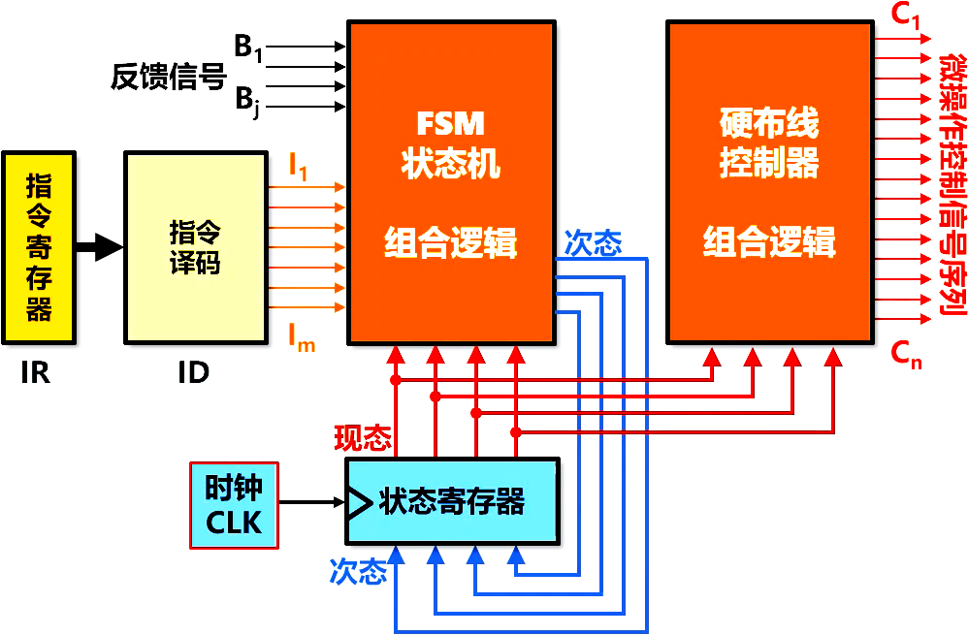
Using FSM to design a Hardwired Controller

Slide 24
单选题
1分
What is the primary purpose of using a Finite State Machine (FSM) in designing a Hardwired Controller?
A
To simplify the instruction set
B
To manage the control signals for each clock cycle
C
To add optional extension instructions
D
To replace the datapath in the CPU
提交

Slide 25
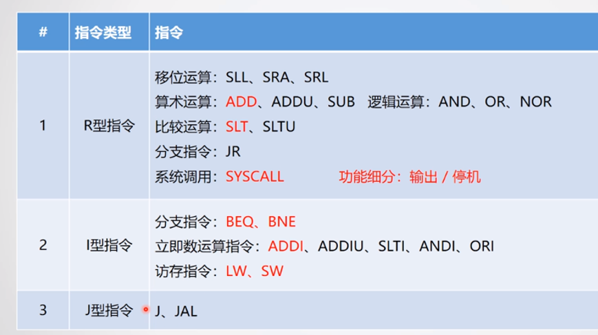
Black represents the optional extension instruction set

Slide 26
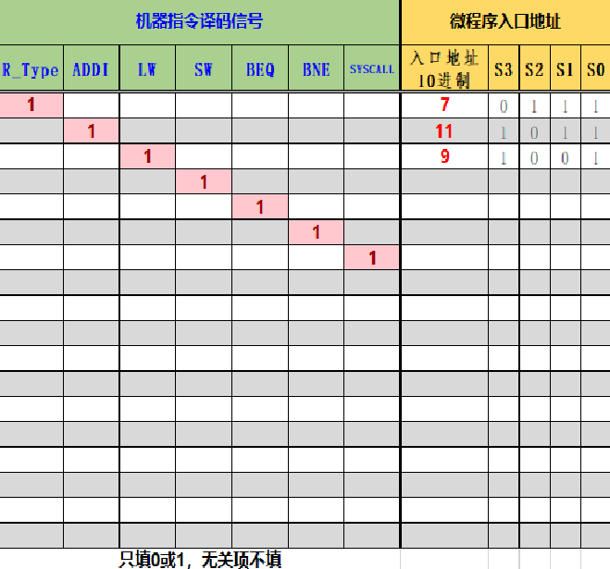
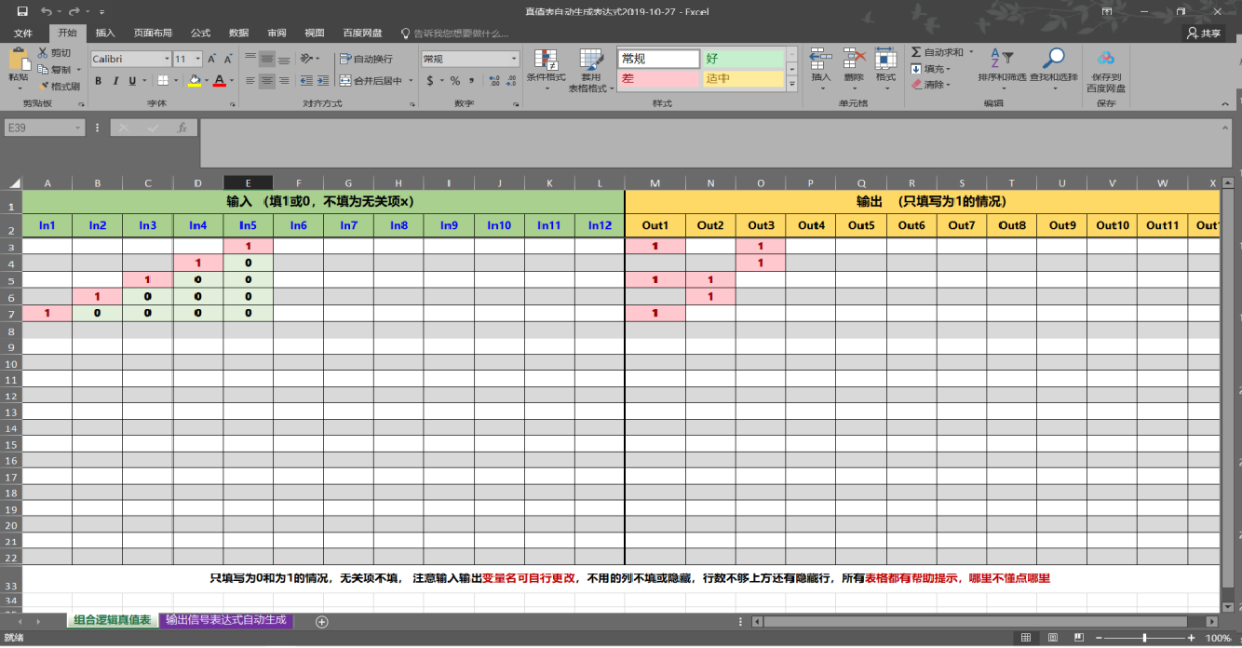
Magical Universal Table
The magical universal table, with 12 inputs and 12 outputs, greatly facilitates the definition of combinatorial logic functions; There are also some variations of the universal table, such as adding decimal number fields.

Slide 27
Question 1: Output logic, 4 inputs and 16 outputs. Solution: Use two universal tables with the same input pins Question 2: If the number of output pins is 4 and the number of input pins is increased to 16, how should it be handled?
Write the function values into the experimental report

